Slide 1
Introduction to Computing
CSC 1108
“HTML, CSS & Logic Building in Computers”
Week 4

Slide 2
Recap
Web Design Vs Web Development
What is Web Designing
What is Web Development
Roadmap
Frameworks
Quick Refresh – HTML
Number Conversions

Slide 3
Content
HTML Attributes
What is Web Designing
What is Web Development
Roadmap
Framworks

Slide 4
HTML Attributes
Provide additional information to HTML elements
<a href="https://www.google.com">Hello to Web Programming Class</a>
<img src="img.jpg" width="500" height="600">
<img src="img.jpg" alt= “Loving this class">
Style Attributes
<p style="color:red;">This is a red paragraph.</p>

Slide 5
HTML Styling
Background Color
  <body style="background-color:powderblue;">
  <body>
  <h1 style="background-color:green;">This is a heading</h1>
  <p style="background-color:red;">This is a paragraph.</p>
  </body>
Text Colour : <p style="color:red;">This is a paragraph.</p>
Fonts: <p style="font-family:courier;">This is a paragraph.</p>
Font Size: <p style="font-size:160%;">This is a paragraph.</p>
Font alignment<p style="text-align:center;">Centered paragraph.</p>

Slide 6
HTML Styling
Border Color
  <h1 style="border:2px solid Tomato;">Hello World</h1>
CSS Styling
  Inline CSS
  Internal CSS
  External CSS
Other Styles
  Padding: Space between text and border
  Margin: space outside the border
  Hyperlinks: <a href="url">link text</a>
  Absolute URLS vs Relative Urls
  Image as a link: <a href=”homepage.html"><img src=”logo.gif" alt="HTML tutorial" style="width:42px;height:42px;"></a>
  LETs TRY IT!!

Slide 7
HTML Styling
Other Styles
  Padding: Space between text and border
  Margin: space outside the border
  Hyperlinks: <a href="url">link text</a>
  Absolute URLS vs Relative Urls
  Image as a link: <a href=”homepage.html"><img src=”logo.gif" alt="HTML tutorial" style="width:42px;height:42px;"></a>
  Email Link: <a href="mailto:someone@example.com">Send email</a>
  LETs TRY IT!!

Slide 8
HTML Styling
HTML Formatting
<b> - Bold text
<strong> - Important text
<i> - Italic text
<em> - Emphasized text
<mark> - Marked text
<small> - Smaller text
<del> - Deleted text
<ins> - Inserted text
<sub> - Subscript text
<sup> - Superscript text

Slide 9
Tables
<table>
<tr>
<th> ____________</th>
<th>_____________</th>
</tr>
<tr>
<td>______________</td>
<td>______________</td>
</tr>
</table>
We can also apply styling to the tables

Slide 10
Table Div Elements
Used to make divisions of the web page
<div></div>
Groups various elements

Slide 11
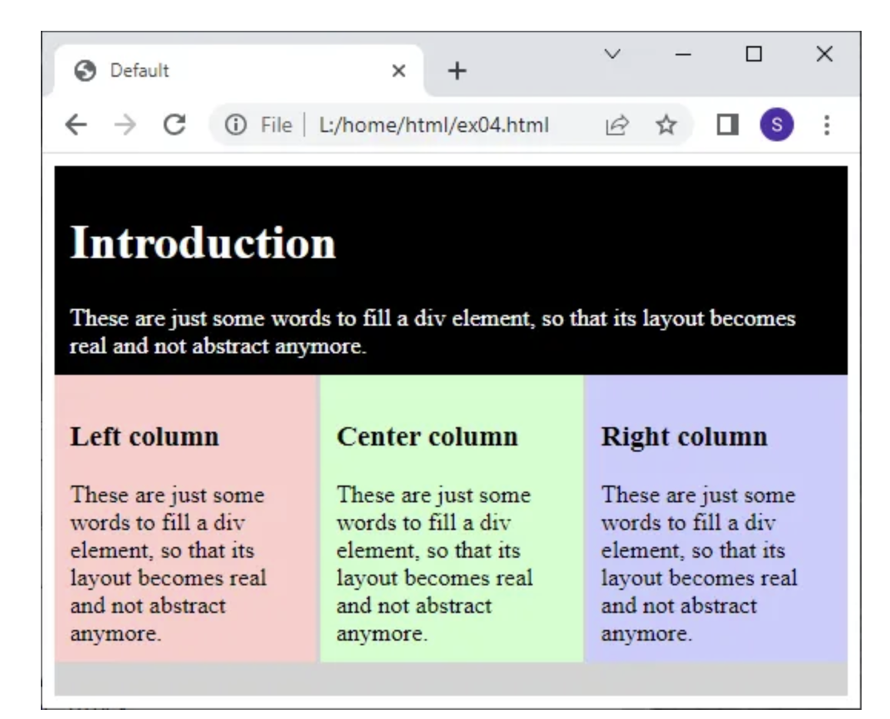

Slide 12
p {
text-align: center;
color: red;
}
#p1 {
text-align: center;
color: red;
}
.p1 {
text-align: center;
color: red;
}
p.center {
text-align: center;
color: red;
}

Slide 13
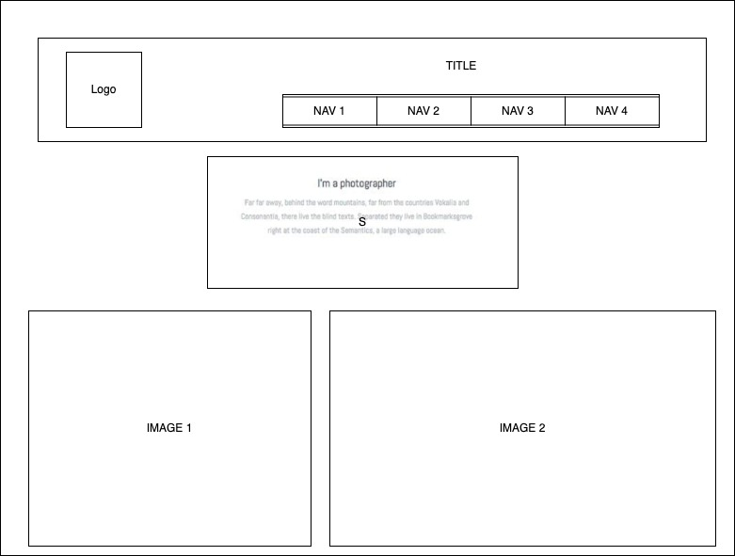
Assignment

Slide 14
Logic Building
Computer programs are used to solve real life problems
Programming languages give you the platform to solve your problems
A good programmer must know the problem solving and analytical skills except than programming skills
Developing a solution to the problem requires logic such as:
  Understanding and analyzing the problem
  Discovering a plan to solve the problem
  Designing/building a solution using any programming language

Slide 15
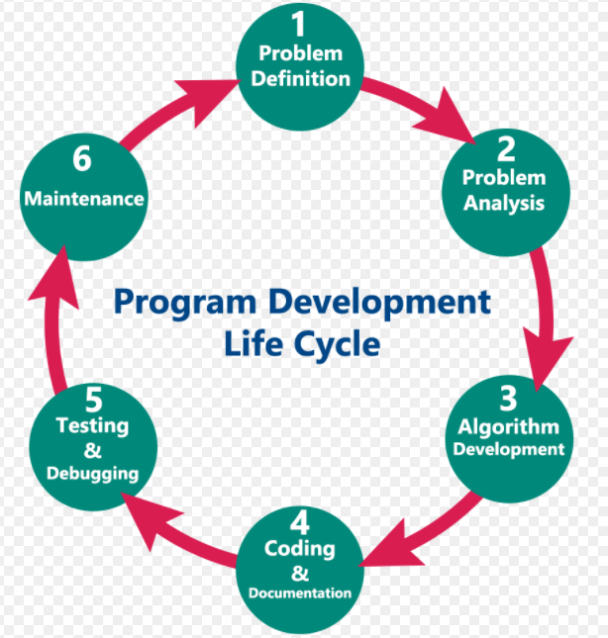
Program Development Life Cycle (PDLC)
Series of steps programmers use to build computer programs
Steps of PDLC are:
  Problem Definition
  Problem Analysis
  Algorithm Development
  Coding & Documentation
  Testing the Solution
  Maintenance

Slide 16
PDLC Phases
Problem Definition
  Define the problem statement
  Decide the boundaries of the problem
  Understand the problem statement
  Understand what are the requirements
  Understand what is the output expected of the problem solution
Problem Analysis
  Determine the requirements like variables, functions, etc.
  Determine the resources required to solve the problem
  Determine the limitations of the solution

Slide 17
PDLC Phases
Algorithm Development
  Develop a step by step procedure to solve the problem using the specification given in the previous phase - writing the solution in step by step statements
Coding & Documentation
  Using a programming language implement steps defined in the previous phase - constructing actual program
Testing the Solution
  Check whether the code written in previous step is solving the specified problem or not
  Testing the program whether it is solving the problem for various input data values or not

Slide 18
PDLC Phases
Maintenance
  Program is actively used by the users if any enhancements found in this phase, all the phases are to be repeated again to make the enhancements, so that the encountered problem is solved or enhancement is added.

Slide 19
Algorithm
Sequence of steps to be performed in order to solve a problem
Characteristics of an algorithm:
  Well-ordered: the steps are in a clear order
  Unambiguous: the operations described are understood by a programmer without further simplification
  Effectively computable: the programmer can actually carry out the operation
Can be expressed in many different notations, including natural language, pseudocode, flowcharts
Algorithms are theoretical study of computer program performance and resource usage and practiced abstractly without the use of specific programming language or implementation

Slide 20
Significance of Algorithms
Algorithm analysis enable programmer to predict the performance of different algorithms in order to guide program design decisions.
Most algorithms do not perform the same in all cases; normally an algorithm’s performance varies with the data passed to it.
Typically, three cases are recognized:
  the best case,
  average case and
  worst case.

Slide 21
Writing algorithm…
Define the problem
List the inputs (information to solve the problem) and the outputs (what is the expected solution)
Describe the steps needed to convert or manipulate the input to produce output
Test the algorithm

Slide 22
Control Structures
All programs could be written using three control structures:
  Sequence
    The sequence structure is the construct where one statement is executed after another
  Selection
    The selection structure is the construct where statements can executed or skipped depending on whether a condition evaluates to TRUE or FALSE
  Repetition
    The repetition structure is the construct where statements can be executed repeatedly until a condition evaluates to TRUE or FALSE

Slide 23
Sequence Control Structure
Statements are executed in a specified order
No statement is skipped
No statement is executed more than once
Example: to calculate the percentage
Take marks obtained
Take total marks
Calculate percentage = marks obtained * 100 / total marks
Display marks

Slide 24
Selection Control Structure
There are three selection structures in C:
IF
IF – ELSE
SWITCH

Slide 25
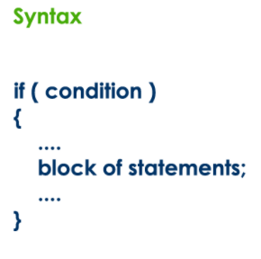
IF Selection Control Structure
IF statement is used to verify the given condition and executes the block of statements based on the condition result.
The simple if statement evaluates specified condition.
If it is TRUE, it executes the next statement or block of statements.
If the condition is FALSE, it skips the execution of the next statement or block of statements.

Slide 26
IF Selection Control Structure
Example:
Take a number from user as input
If number < 20
Print number is less than 20
Print “statement does not belong to if”

Slide 27
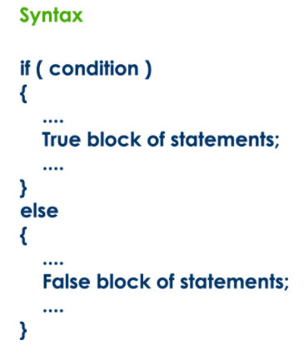
IF-ELSE Selection Control Structure
Verifies the given condition and executes only one out of the two blocks of statements based on the condition result.
The if-else statement evaluates the specified condition.
  If it is TRUE, it executes a block of statements (True block).
  If the condition is FALSE, it executes another block of statements (False block).

Slide 28
IF-ELSE Selection Control Structure
Example: to check whether number is divisible by 2
Take a number as input from user
if number is divided by 2 and remainder is zero
Print number is divisible by 2
Else
Print number is not divisible by 2

Slide 29
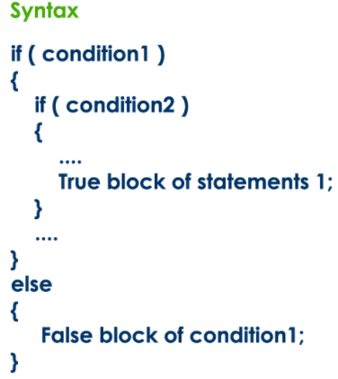
Nested IF-ELSE Statements
Writing a if statement inside another if statement is called nested if statement.

Slide 30
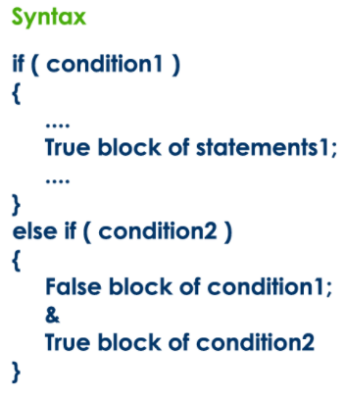
IF - ELSE - IF Statement (if-else ladder)
Writing a if statement inside else of a if statement is called if - else - if statement.

Slide 31
SWITCH Statement
When we have more number of options out of which we need to select only one option that is to be executed
In switch statement, we provide a value that is to be compared with a value associated with each option.
Whenever the given value matches with the value associated with an option, the execution starts from that option.
In switch statement every option is defined as a case.

Slide 32
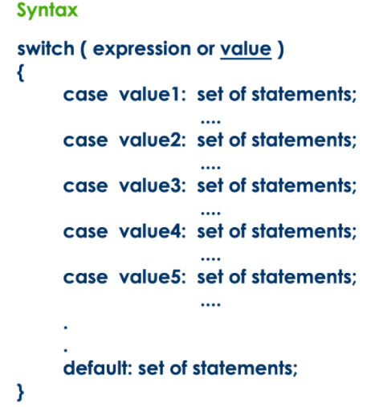
SWITCH Statement

Slide 33
Repetition Control Structure
There are three repetition structures in C:
WHILE
DO – WHILE
FOR

Slide 34
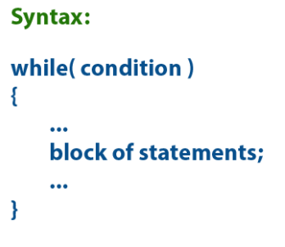
WHILE Repetition Control Structure
The while statement is used to execute a single statement or block of statements repeatedly as long as the given condition is TRUE.

Slide 35
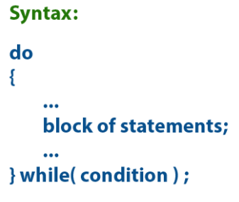
DO-WHILE Repetition Control Structure
The do-while statement is used to execute a single statement or block of statements repeatedly as long as given the condition is TRUE.

Slide 36
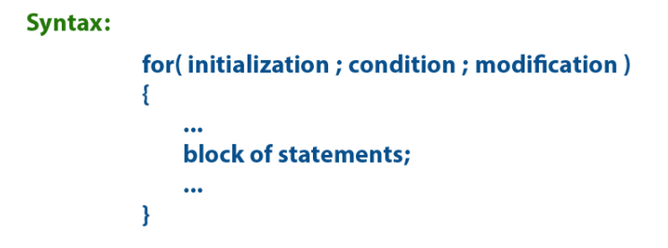
FOR Repetition Control Structure
The for statement is used to execute a single statement or a block of statements repeatedly as long as the given condition is TRUE.

Slide 37
Algorithm Example
A Pseudocode that reads two values, determines the largest value and prints with a message.
Step 1: Input Value1, Value2
Step 2: If (Value1 > Value2) then
Max <- Value1
Else
Max <- Value2
Endif
Step3: Print “The largest value is”, Max

Slide 38
Flowcharts
Graphical or symbolic representation of an algorithm
Step-by step solution to a given problem is presented diagrammatically
Flowcharts are used in analyzing, designing, documenting or managing a process or program
The types of flowcharts are;
  High-Level Flowchart and
  Detailed Flowchart

Slide 39
Flowcharts
Provide ease of communication
Effective and efficient analysis and coding
Proper documentation and maintenance
Limitation
Include complex logic
Multiple modifications

Slide 40
Symbols for Flowcharts
Process: Any type of internal operation: data transformation, data movement, logic operation, etc.
Input/Output: Any input or output of data

Slide 41
Symbols for Flowcharts
Decision: Evaluates a condition or statement and branches depending on whether the evaluation is true or false
Connector: Connects sections of flow chart, so that the diagram can maintain a smooth, linear flow

Slide 42
Symbols for Flowcharts
Terminal: Indicates start or end of a program
Flow Lines: Arrows that indicate the direction of the progression of the program

Slide 43
Rules for flowcharts
All symbols of the flowchart are connected by flow lines (note arrows, not lines)
Flow lines enter the top of the symbol and exit out the bottom, except for the Decision symbol, which can have flow lines exiting from the bottom or the sides
Flowcharts are drawn so flow generally goes from top to bottom
The beginning and the end of the flowchart is indicated using the Terminal symbol

Slide 44
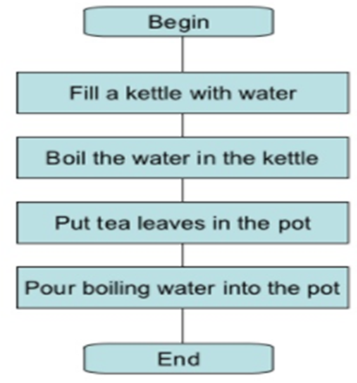
Flow Chart for Sequence Control Structure

Slide 45
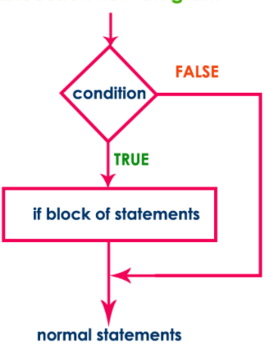
Flow Chart for IF Selection Control Structure

Slide 46
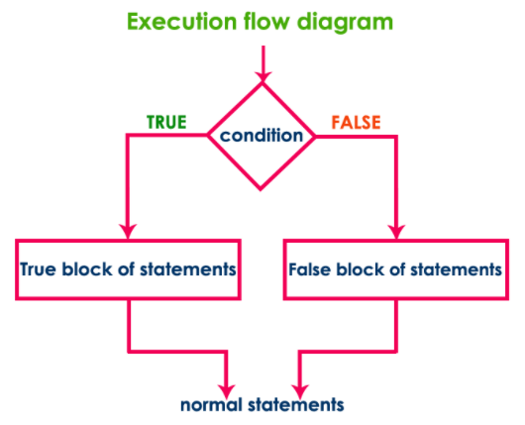
Flow Chart for IF-ELSE Selection Control Structure

Slide 47
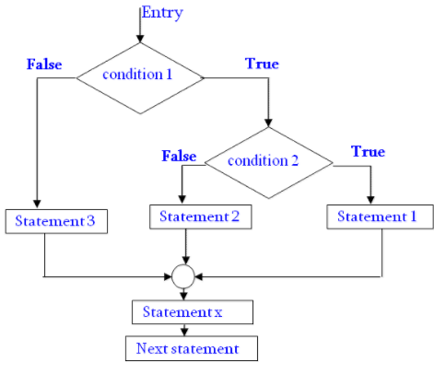
Flow Chart for Nested IF-ELSE Selection Control Structure

Slide 48
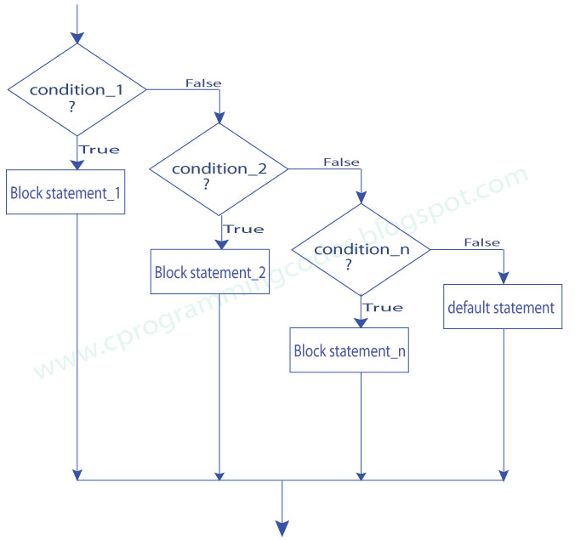
Flow Chart for IF-ELSE-IF Selection Control Structure

Slide 49
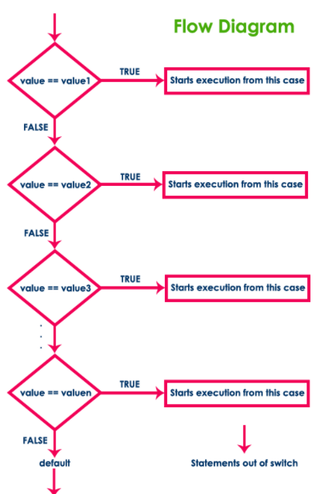
Flow Chart for SWITCH Control Structure

Slide 50
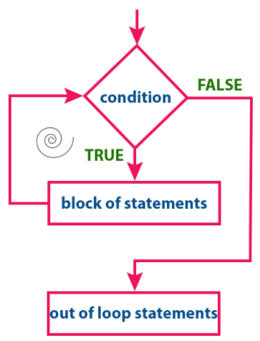
Flow Chart for WHILE Repetition Control Structure

Slide 51
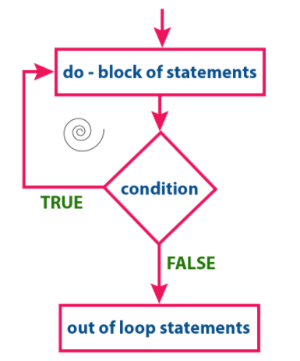
Flow Chart for DO-WHILE Repetition Control Structure

Slide 52
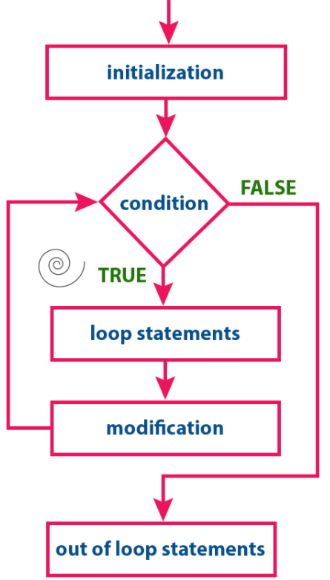
Flow Chart for FOR Repetition Control Structure

Slide 53
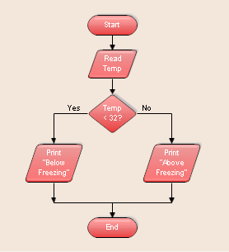
Flow Chart Example

Slide 54
Activity
Write an Algorithm, Pseudocode and draw flowchart for the below scenarios;
Whether to open an umbrella if it is raining
For a robot with a touch sensor to move until it touches an object then stops
To tell how to read a flow chart
To print Fibonacci series up to given number N
To convert a binary number to hex number

